Slide 1
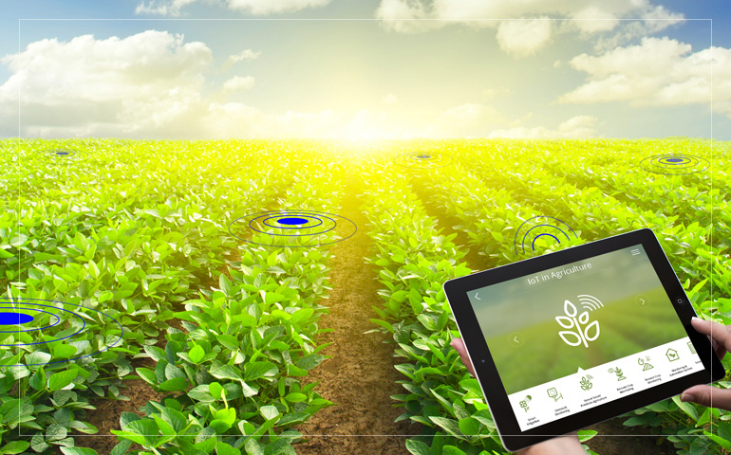

Agricultural Applications of IoT
Presented by- Mr. Anmoldeep Singh Arora And
Miss. Shahana Fatima,
CO dept, Anjuman polytechnic, sadar,
Nagpur

Slide 2
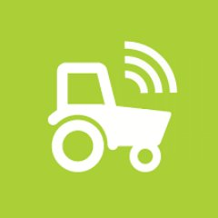
Points to Cover
Types of agriculture in India
What is modern agriculture?
The Benefits of Smart Farming: How IoT Is Shaping Agriculture.
IoT Use Cases in Agriculture.
Why it is important to use IoT?
Some related Project links.

Slide 3
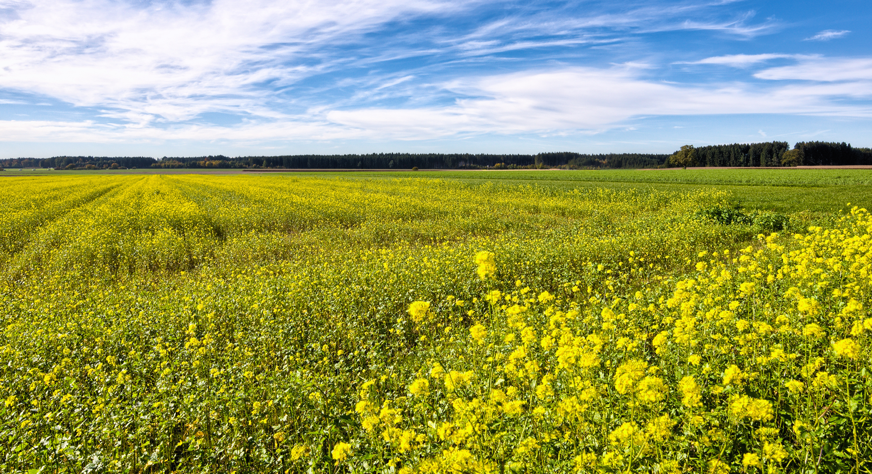
Types of agriculture in India:

Slide 4

Agriculture
Shifting agriculture
Subsistence farming
Extensive agriculture
Plantation agriculture
Dry land farming
Wet land farming

Slide 5
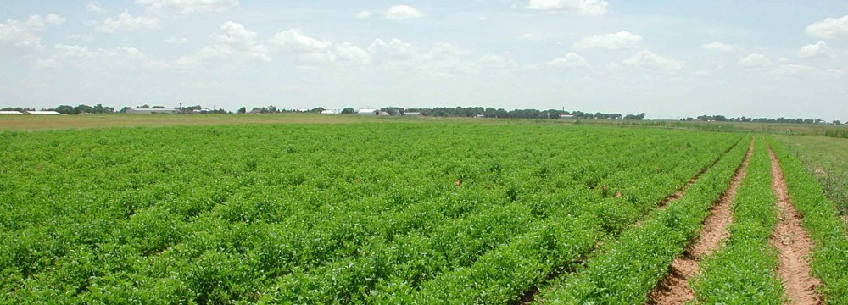
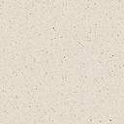
What is modern agriculture?
Modern agriculture is an evolving approach to –
agricultural innovations
farming practices that helps farmers –
increase efficiency
reduce the amount of natural resources—water, land, and energy—necessary to meet the world’s food, fuel, and fiber needs

Slide 6
The Benefits of Smart Farming: How IoT Is Shaping Agriculture
Data, tons of data, collected by smart agriculture sensors.
Better control over the internal processes and, as a result, lower production risks.
Cost management and waste reduction thanks to the increased control over production.
Increased business efficiency through process automation.
Enhanced product quality and volumes

Slide 7
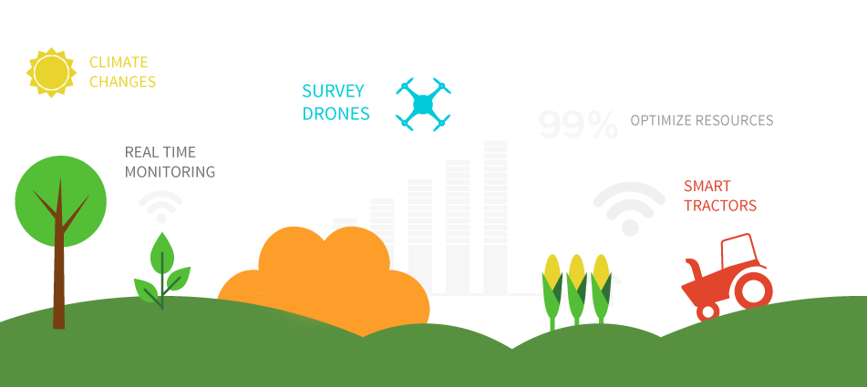
IoT Use Cases in Agriculture

Slide 8
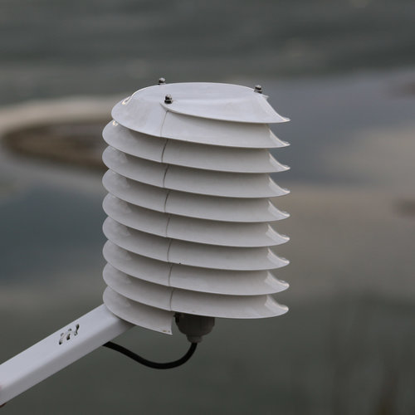
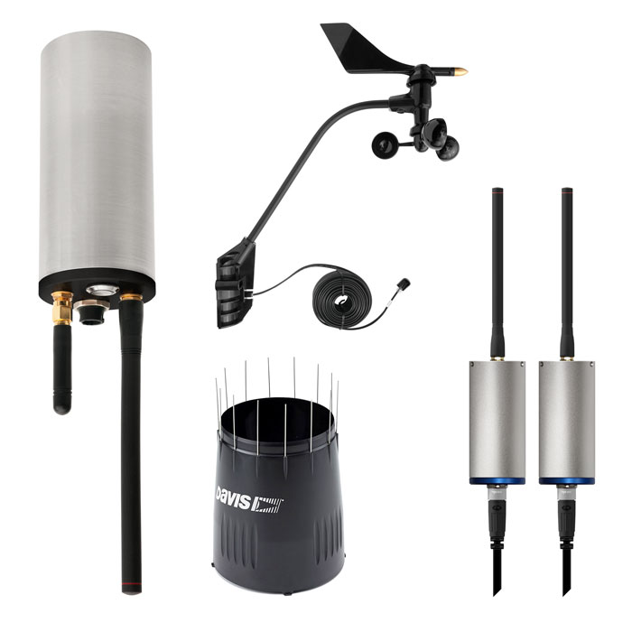
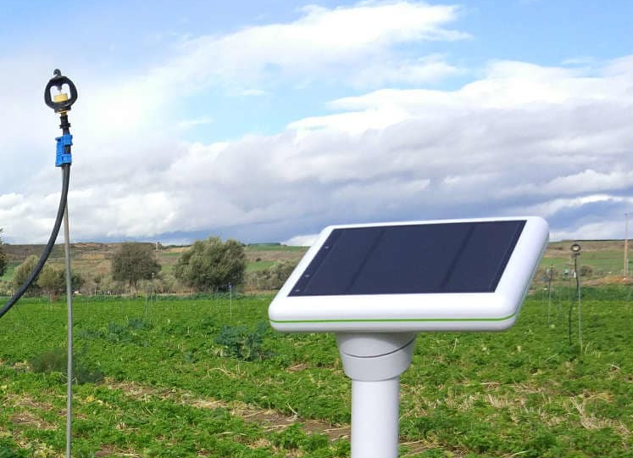
1) Monitoring of Climate Conditions
allMETEO
Smart Elements
Pycno

Slide 9
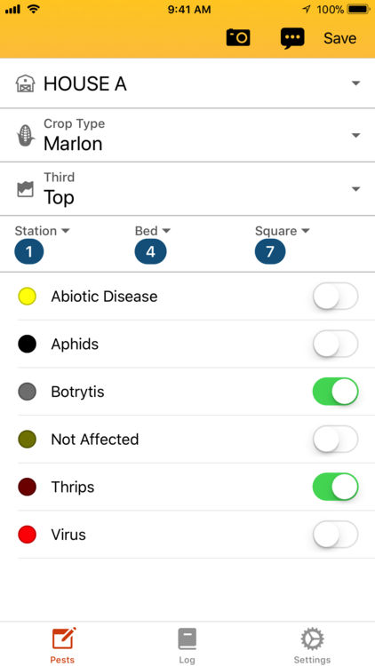
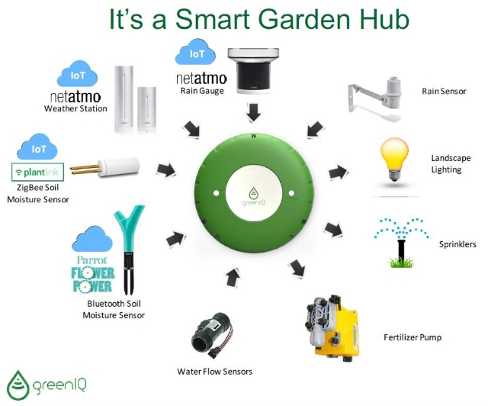
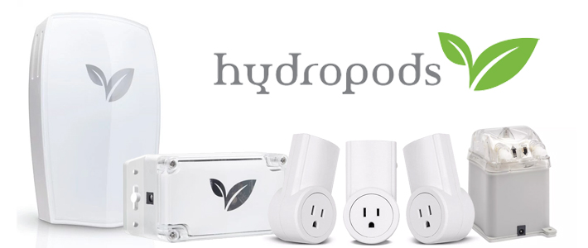
2) Greenhouse Automation
Farmapp
GreenIQ
Growlink

Slide 10

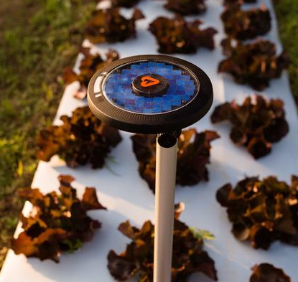
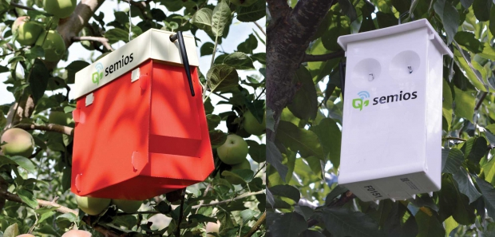

3) Crop Management
Arable
Semios

Slide 11

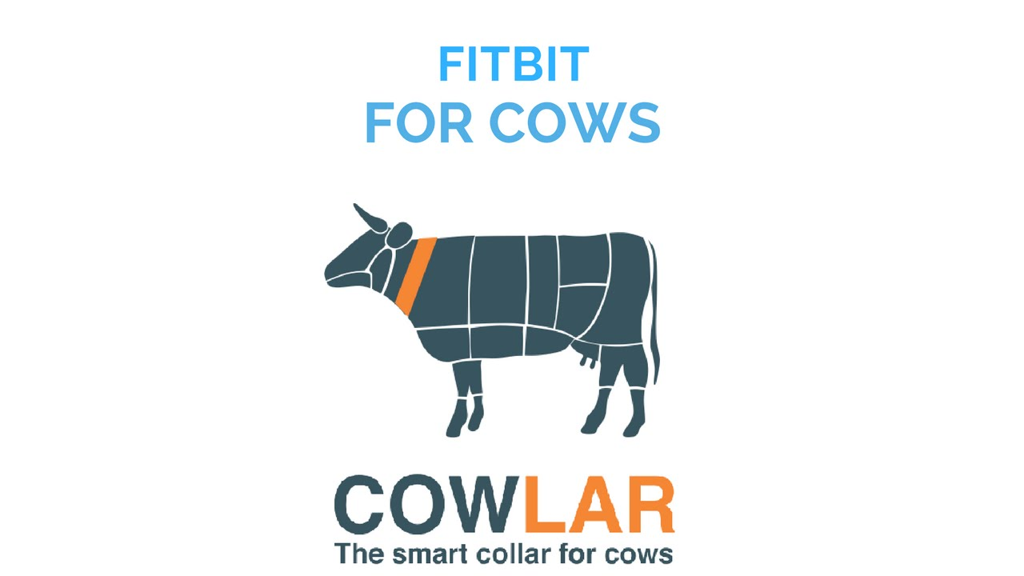
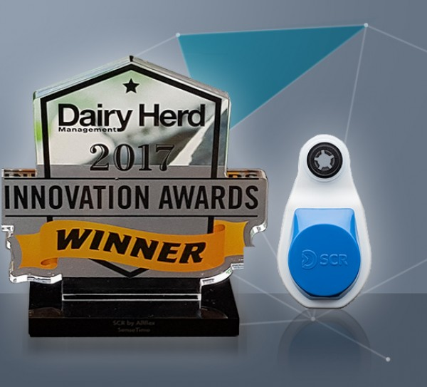
4) Cattle Monitoring and Management
Cowlar
SCR by Allflex

Slide 12
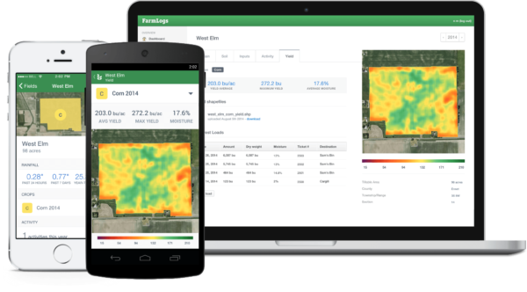
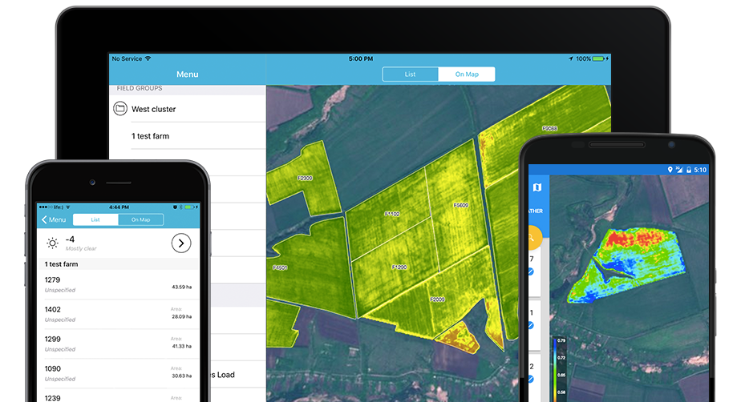
5) End-to-End Farm Management Systems
FarmLogs
Cropio

Slide 13

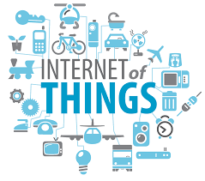
Why it is important to use IoT?
The Internet of Things (IoT) has the capability
to transform the world we live in.
IoT technologies will enable growers
and farmers to reduce waste and
enhance productivity.
Global population is set to touch 9.6 billion by 2050. So, to feed this much population, the farming industry must embrace IoT

Slide 14
Some related Project links
Smart agriculture –
https://www.hackster.io/renesas-team-sece/smart-agriculture-system-with-iot-2efb66
Smart agribot –
https://www.hackster.io/Mokshith/agribot-0a931c
Precision agriculture prototype –
https://www.hackster.io/ransomhall/precision-agriculture-a-prototype-solution-58a43b

Slide 15
Conclusion
By installing smart IoT systems, we can increase competitiveness and sustainability in productions. Farmers and land-lords, can cope with their working challenges easily.
The increasing demand for growing population can be successfully managed.
A brighter and prosperous IOT enabled future is waiting for us.

Slide 16


